Slide 1


E-commerce 2023: business. technology. society.
Seventeenth Edition
Chapter 2
E-commerce Business Models and Concepts
Copyright © 2024, 2022, 2020 Pearson Education, Inc. All Rights Reserved
Notes:
If this PowerPoint presentation contains mathematical equations, you may need to check that your computer has the following installed:
1) MathType Plugin
2) Math Player (free versions available)
3) NVDA Reader (free versions available)

Slide 2
Learning Objectives
2.1 Identify the key components of e-commerce business models.
2.2 Describe the major B2C business models.
2.3 Describe the major B2B business models.
2.4 Understand key business concepts and strategies applicable to e-commerce.

Slide 3
Connected Cars: The Next Big E-commerce Revolution?
Class Discussion
How are new connected car technologies also creating new business models?
What is the potential impact on different forms of e-commerce, such as the content industry?
Why are tech companies so interested in the connected car platform?
Are there any issues with respect to “connected” cars?

Slide 4
E-commerce Business Models
Business model
Set of planned activities designed to result in a profit in a marketplace
Business plan
Describes a firm’s business model
E-commerce business model
Uses/leverages unique qualities of Internet and Web

Slide 5
B2C Business Models
Online retailer (e-tailer)
Community provider (social network)
Content provider
Portal
Transaction broker
Market creator
Service provider
Hybrid (e.g e-tailer + Service provider)

Slide 6
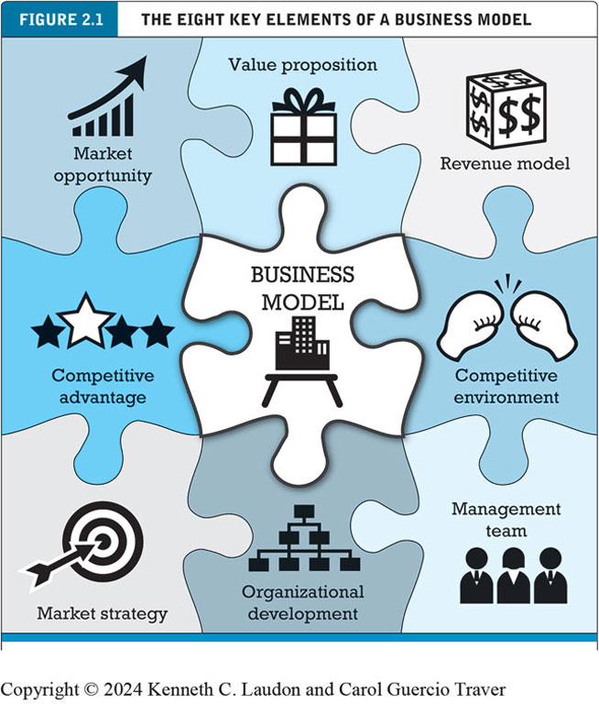
Notes:
Figure 2.1, page 57.
A business model has eight key elements. Each element must be addressed if you hope to be successful.
Alt Text
Long description: The puzzle has 9 pieces. Each piece of the jigsaw puzzle has an icon and a title. In the middle, the piece has the title business model, and the icon is a table that has a building on it. Starting from the top left in a clockwise direction, the titles of the pieces are market opportunity, value proposition, revenue model, competitive environment, management team, organizational development, market strategy, and competitive advantage. The icons are as follows: a concave-up decreasing graph icon, a gift icon, a dollar dice icon, a boxing gloves icon, a three figures icon, a hierarchical graph icon, a bullseye icon, and a 4-star icon, respectively.

Slide 7
Eight Key Elements of a Business Model
Value proposition
Revenue model
Market opportunity
Competitive environment
Competitive advantage
Market strategy
Organizational development
Management team

Slide 8
1. Value Proposition
“Why should the customer buy from you?”
Successful e-commerce value propositions:
Personalization/customization
Reduction of product search, price discovery costs
Facilitation of transactions by managing product delivery

Slide 9
2. Revenue Model
“How will you earn money?”
Major types of revenue models
Advertising revenue model
Subscription revenue model
Freemium strategy
Transaction fee revenue model
Sales revenue model
Affiliate revenue model

Slide 10
Insight on Society: Foursquare’s Evolving Business Model: Leveraging Your Location
Class Discussion
Why has the shift in Foursquare’s business model been the key to success for Foursquare?
What is your opinion of Foursquare’s characterization of itself as one of the “good guys” in the location data industry?
How is Foursquare attempting to cope with a more privacy-conscious business environment?

Slide 11
3. Market Opportunity
“What marketspace do you intend to serve and what is its size?”
Marketspace: Area of actual or potential commercial value in which company intends to operate
Realistic market opportunity: Defined by revenue potential in each market niche in which company hopes to compete
Market opportunity typically divided into smaller niches

Slide 12
4. Competitive Environment
“Who else occupies your intended marketspace?”
Other companies selling similar products in the same marketspace
Includes both direct and indirect competitors
Influenced by:
Number and size of active competitors
Each competitor’s market share
Competitors’ profitability
Competitors’ pricing

Slide 13
5. Competitive Advantage
“What special advantages does your firm bring to the marketspace?”
Is your product superior to or cheaper to produce than your competitors’?
Important concepts:
Asymmetries
First-mover advantage, complementary resources
Unfair competitive advantage
Leverage
Perfect markets

Slide 14
6. Market Strategy
“How do you plan to promote your products or services to attract your target audience?”
Details how a company intends to enter market and attract customers
Best business concepts will fail if not properly marketed to potential customers

Slide 15
7. Organizational Development
“What types of organizational structures within the firm are necessary to carry out the business plan?”
Describes how firm will organize work
Typically, divided into functional departments
As company grows, hiring moves from generalists to specialists

Slide 16
8. Management Team
“What kind of backgrounds should the company’s leaders have?”
A strong management team:
Can make the business model work
Can give credibility to outside investors
Has market-specific knowledge
Has experience in implementing business plans

Slide 17
Raising Capital
Seed capital
Elevator pitch
Traditional sources
Incubators, angel investors
Commercial banks, venture capital firms
Strategic partners
Equity crowdfunding
J O B S Act

Slide 18
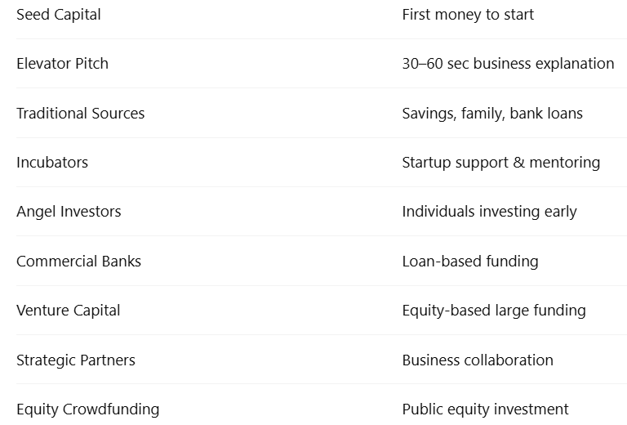

Slide 19
Insight on Business: Startups Turn to Crowdfunding
Class Discussion
Would you feel comfortable investing in a startup that raises capital using equity crowdfunding? Why or why not?
Why is it important to democratize access to capital?
What obstacles are presented in the use of crowdfunding as a method to fund startups?

Slide 20
Categorizing E-commerce Business Models
No one correct way to categorize
Text categorizes according to:
E-commerce sector (e.g., B2B)
E-commerce technology (e.g., m-commerce)
Similar models appear in different sectors
Companies may use multiple business models (e.g., eBay)
E-commerce enablers

Slide 21
B2C Business Models
Online retailer (e-tailer)
Community provider (social network)
Content provider
Portal
Transaction broker
Market creator
Service provider
Hybrid (e.g e-tailer + Service provider)

Slide 22
B2C Models: Online Retailer (E-tailer)
Online version of traditional retailer
Revenue model
Sales
Variations
Virtual merchant
Bricks-and-clicks
Catalog merchant
Manufacturer-direct
Low barriers to entry

Slide 23
B2C Models: Community Provider
Provide online environment (social network) where people with similar interests can transact, share content, and communicate
Examples: Facebook, TikTok, LinkedIn, Twitter, Pinterest
Revenue models
Typically use a hybrid model, combining advertising, subscriptions, sales, and transaction fees

Slide 24
B2C Models: Content Provider
Digital content on the Web
News, music, video, text, artwork
Revenue models
Use variety of models, including advertising, subscription; sales of digital goods
Key to success is typically owning the content
User-generated content, creators, and the creator economy
Playing an ever-increasing role in online content landscape

Slide 25
B2C Business Models: Portal
Search plus an integrated package of content and services
Revenue models
Advertising, referral fees, transaction fees, subscriptions for premium services
Variations
Horizontal/general: (examples: Yahoo, A O L, M S N)
Vertical/specialized (vortal): (example: Sailnet)
Search: (examples: Google, Bing)

Slide 26
B2C Models: Transaction Broker
Process online transactions for consumers
Primary value proposition-saving time and money
Revenue model
Transaction fees
Industries using this model
Financial services
Travel services

Slide 27
B2C Models: Market Creator
Create digital environment where buyers and sellers can meet and transact
Examples: Priceline, eBay, Etsy
Revenue model: Transaction fees, fees to merchants for access
On-demand service companies (sharing economy): platforms that allow people to sell services
Examples: Uber, Airbnb

Slide 28
Insight on Technology: Behind the Scenes at Etsy
Class Discussion
What are the technologies that Etsy uses to create an online platform for sellers and buyers?
What issues did Etsy face creating its platform?
Have you ever used Etsy as either a seller or buyer? What was your experience with the platform?
What challenges does Etsy face in the future?

Slide 29
B2C Models: Service Provider
Online services
Example: Google
Google Maps, Gmail, and so on
Value proposition
Valuable, convenient, time-saving, low-cost alternatives to traditional service providers
Revenue models
Sales of services, subscription fees, advertising, sales of marketing data

Slide 30
B2B Business Models
B2B e-commerce marketplaces
E-distributors
E-procurement companies
Exchanges
Industry consortiums
Private B2B networks

Slide 31
B2B Models: E-distributors
Version of retail and wholesale store, M R O goods, and indirect goods
Owned by one company seeking to serve many customers
Revenue model: Sales of goods
Example: Grainger

Slide 32
B2B Models: E-procurement Companies
Creates digital markets where participants transact for indirect goods
B2B service providers, S a a S and P a a S providers
Scale economies
Revenue model
Service fees, supply-chain management, fulfillment services
Example: Ariba

Slide 33
B2B Models: Exchanges
Independently owned vertical digital marketplace for direct inputs
Revenue model: Transaction, commission fees
Create powerful competition between suppliers
Tend to force suppliers into powerful price competition; number of exchanges has dropped dramatically
Example: Go2Paper

Slide 34
B2B Models: Industry Consortiums
Industry-owned vertical digital marketplace open to select suppliers
More successful than exchanges
Sponsored by powerful industry players
Strengthen traditional purchasing behavior
Revenue model: Transaction, commission fees
Example: SupplyOn

Slide 35
B2B Models: Private B2B Networks
Digital network used to coordinate among firms engaged in business together
Typically evolve out of large company’s internal enterprise system
Key, trusted, long-term suppliers invited to network
Example: Walmart’s network for suppliers

Slide 36
How E-commerce Changes Business
E-commerce changes industry structure by changing:
Rivalry among existing competitors
Barriers to entry
Threat of new substitute products
Strength of suppliers
Bargaining power of buyers
Industry structural analysis

Slide 37
Industry Value Chains
Set of activities performed by suppliers, manufacturers, transporters, distributors, and retailers that transform raw inputs into final products and services
Internet reduces cost of information and other transactional costs
Leads to greater operational efficiencies, lowering cost, prices, adding value for customers

Slide 38
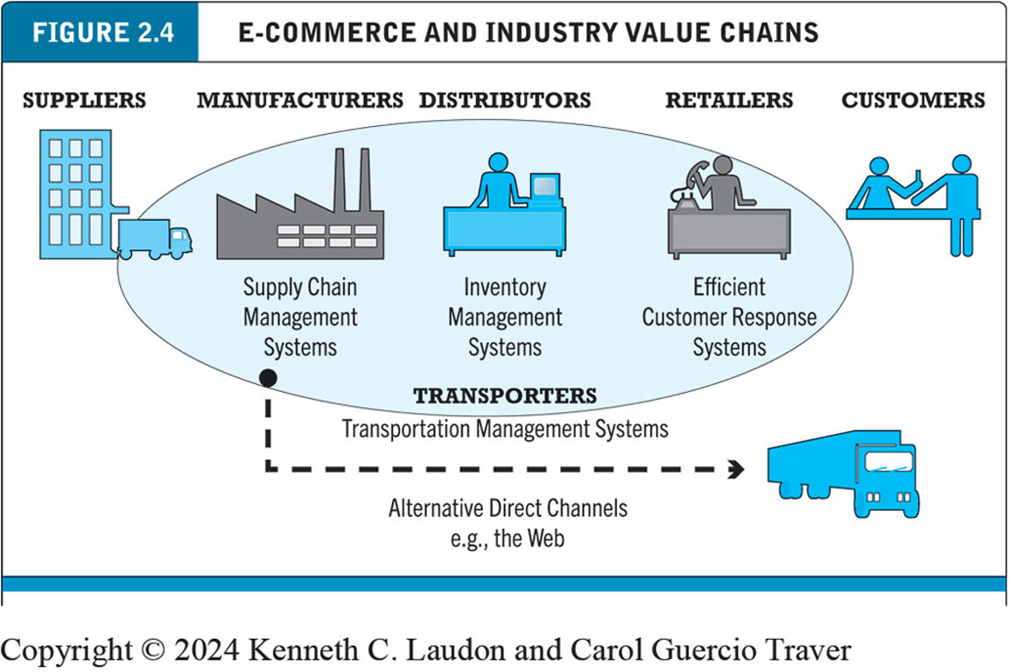
Figure 2.4 E-commerce and Industry Value Chains
Notes:
Figure 2.4, Page 86.
Every industry can be characterized by a set of value-adding activities performed by a variety of actors. E-commerce potentially affects the capabilities of each player as well as the overall operational efficiency of the industry.
Alt Text
Long description: The value chain from left to right is as follows: suppliers, manufacturers, distributors, retailers, and customers. Manufacturers use supply chain management systems. Distributors use inventory management systems. Retailers use efficient customer response systems. Customers are the last link in the chain. Supply chain management systems, inventory management systems, and efficient customer response systems are transporters. Manufacturers can use transporters with transportation management systems to move inventory directly to customers via alternative direct channels, such as the Web.

Slide 39
Firm Value Chains
Activities that a firm engages in to create final products from raw inputs
Each step adds value
Effect of Internet:
Increases operational efficiency
Enables product differentiation
Enables precise coordination of steps in chain

Slide 40
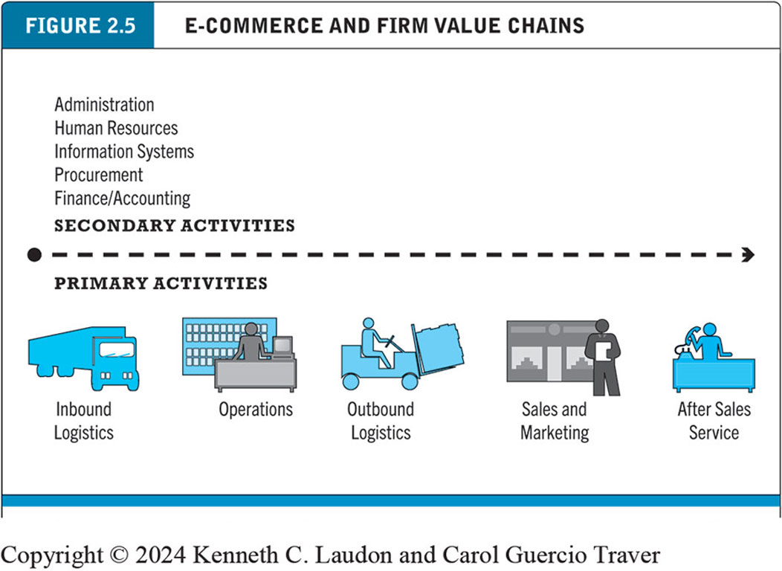
Figure 2.5 E-commerce and Firm Value Chains
Notes:
Figure 2.5, page 87.
Every firm can be characterized by a set of value-adding primary and secondary activities performed by a variety of actors in the firm. A simple firm value chain performs five primary value-adding steps: inbound logistics, operations, outbound logistics, sales and marketing, and after sales service.
Alt Text
Long description: The diagram is divided into primary and secondary activities. Primary activities in the firm value chain from left to right are inbound logistics, operations, outbound logistics, sales and marketing, and after sales service. Secondary activities include administration, human resources, information systems, procurement, and finance or accounting.

Slide 41
Firm Value Webs
Networked business ecosystem
Uses Internet technology to coordinate the value chains of business partners
Coordinates a firm’s suppliers with its own production needs using an Internet-based supply chain management system

Slide 42
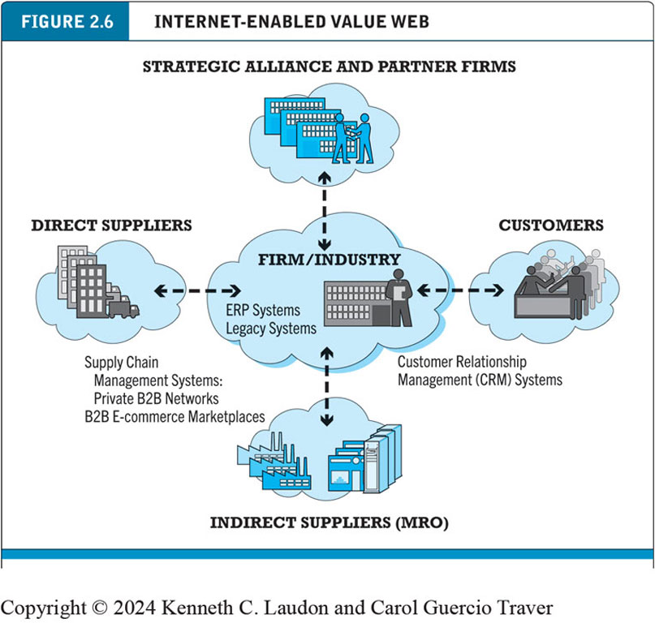
Figure 2.6 Internet-enabled Value Web
Notes:
Figure 2.6, page 88.
Internet technology enables firms to create an enhanced value web in cooperation with their strategic alliance and partner firms, customers, and direct and indirect suppliers.
Alt Text
Long description: In a value web, firm or industry in the middle is connected to strategic alliance and partner firms, customers through customer relationship management or C R M systems, indirect suppliers or M R O, and direct suppliers through E R P systems and legacy systems and supply chain management systems: private B 2 B networks and B 2 B e-commerce marketplaces.

Slide 43
Business Strategy
Plan for achieving superior long-term returns on capital invested: that is, profit
Five generic strategies
Product/service differentiation
Cost competition
Scope
Focus/market niche
Customer intimacy

Slide 44
E-commerce Technology and Business Model Disruption
Disruptive technologies
Digital disruption
Sustaining technology
Stages
Disruptors introduce new products of lower quality
Disruptors improve products
New products become superior to existing products
Incumbent companies lose market share

Slide 45
Careers in E-commerce
Position: Assistant Manager of E-business
Qualification/Skills
Preparing for the Interview
Possible Interview Questions

Slide 46

Copyright
This work is protected by United States copyright laws and is provided solely for the use of instructors in teaching their courses and assessing student learning. Dissemination or sale of any part of this work (including on the World Wide Web) will destroy the integrity of the work and is not permitted. The work and materials from it should never be made available to students except by instructors using the accompanying text in their classes. All recipients of this work are expected to abide by these restrictions and to honor the intended pedagogical purposes and the needs of other instructors who rely on these materials.

